Slide 1
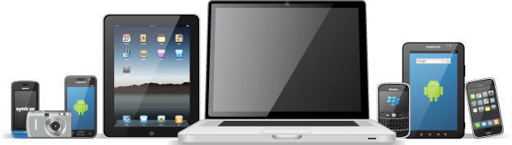
My School and the School Network
Year 8 Information and Communications Technology

Slide 2






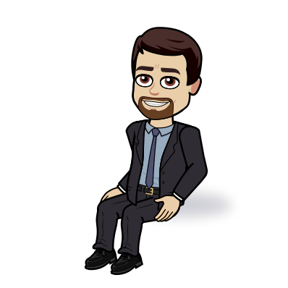



Welcome to KS3 ICT
Year 8
Introductions to ICT + Activities
Year 9
Some new packages/applications + Website Design
Year 10
Under the Hood of a Computer + Introduction to Programming
“You don’t have to be great to start, but you have to start to be great”

Slide 3



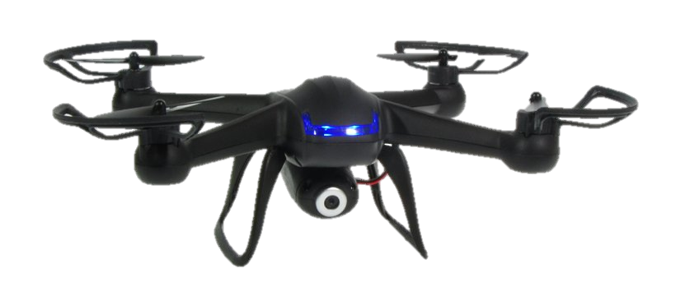


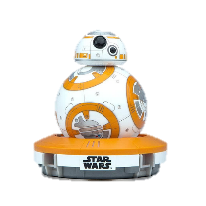





Why Study ICT?
Within KS3 ICT, you’re going to learn a whole lot about the world of computers – far more than just how to turn on a games console or use an app on a phone.
ICT in Secondary School is going to teach you about what actually goes on behind the scenes of a computer – and also introduce you to programming your own computer!

Slide 4







Year 8 ICT
INTRODUCTION
My School
Google Classroom
ICT Contracts
File Management
UNDER THE HOOD
Input and Output Devices
Computer Hardware
Binary
Flowcharts
Variables
E SAFETY
Online Activity
Risks taken online
SPREADSHEETS
Key Aspects of Spreadsheets
Formulas and Functions

Slide 5




Google Classroom
I will be uploading lessons, handouts and homework through Google Classroom. It is important you take note of my email in case you are unable to access resources.
MR BUTLER
ICT

Slide 6
Acceptable Use of Our Computers
It is very important that we all use the School Network for our education.
All users of the network are expected to act responsibly and to show consideration to others.
Using the school network for non educational purposes will bring about sanctions.

Slide 7
Acceptable Use Policy
Never tell anyone your password.
Users should not logon to or use any account other than their own and should logoff when leaving a workstation.
It is not acceptable to: to download, store or install software to school computers.
It is not acceptable to:
  Attempt to introduce a virus or malicious code to the network.
  Access, download, create, store or transmit material that; is indecent or obscene and brings the name of the school into disrepute.
The use of public chat facilities and social networks is not permitted.
Users should not directly copy and use material from the Internet in their school work.

Slide 8
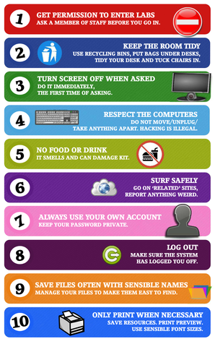
Top 10 Rules of the Computer Room

Slide 9

The School Computer Contract
Before you can use the computers within school, you need to first agree to some terms and conditions of use.
What rules do you think we should include that we have just discussed? Are they all within this contract?

Slide 10
Note: Absence from Class
If you are absent for any reason from an ICT lesson, it is your responsibility to catch up before next lesson.
This includes:
  Checking if any homework is due (and needs to be completed)
  Catch up on any work/notes missed. If you do not understand what you have missed, see me before the next lesson.
  If there was a class test, you need to see me before next lesson to complete this or so I can arrange a time for you to do the test.
I will not accept ‘I wasn’t here last lesson’ as an excuse for not completing homework.

Slide 11

Pupil Baseline Survey
https://forms.gle/E3vio97kpBb1AwWm8
Notes:
TEACHER INFO: Each year, this link needs to be updated to ensure correct copies are kept.

Slide 12
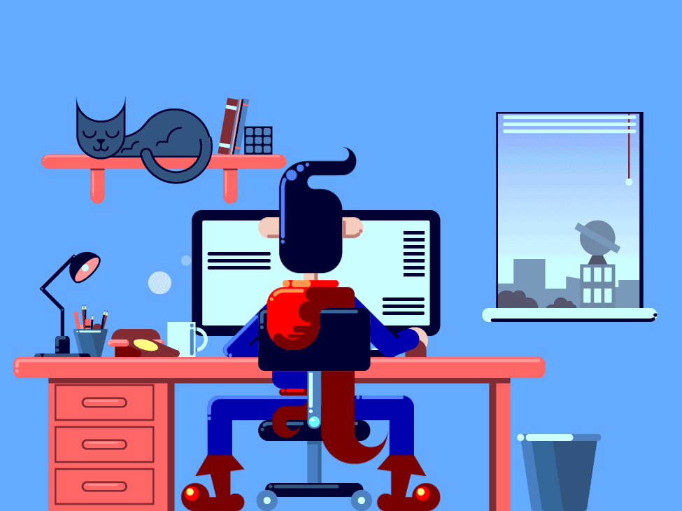
Q1. What is a computer?
A Computer is a type of machine.
It is used for storing and processing data according to instructions given to it in a variable program.
It doesn’t have a brain like humans so can’t think or have ideas, but can do lots of useful things.

Slide 13
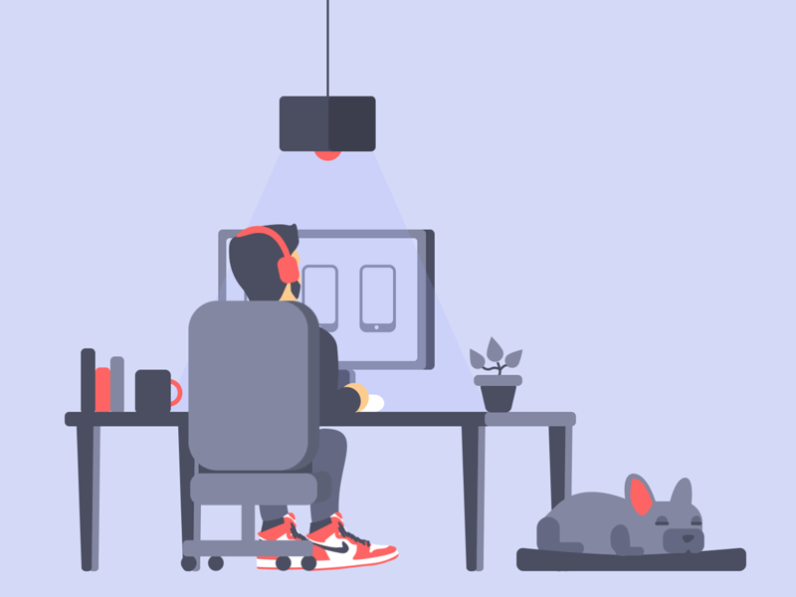
What is a Network?
A network is made when two or more computers are joined together.
This means they can communicate with each other, and also share things like printers and files.
A computer which doesn’t share or broadcast data is not a network.

Slide 14




What Computer Networks have you used before?
You have used different types of networks. You may have already used:
Home Wifi
Social Networks
So how many here use:
  Facebook?
  Twitter?
  Instragram?
  Snapchat?
  Tik-Tok?
  Pinterest?
The Internet
Gaming Networks

Slide 15

The Internet
The internet is a world wide network. It allows computers from all over the world to communicate with each other, such as sending email, online gaming and social networks.

Slide 16
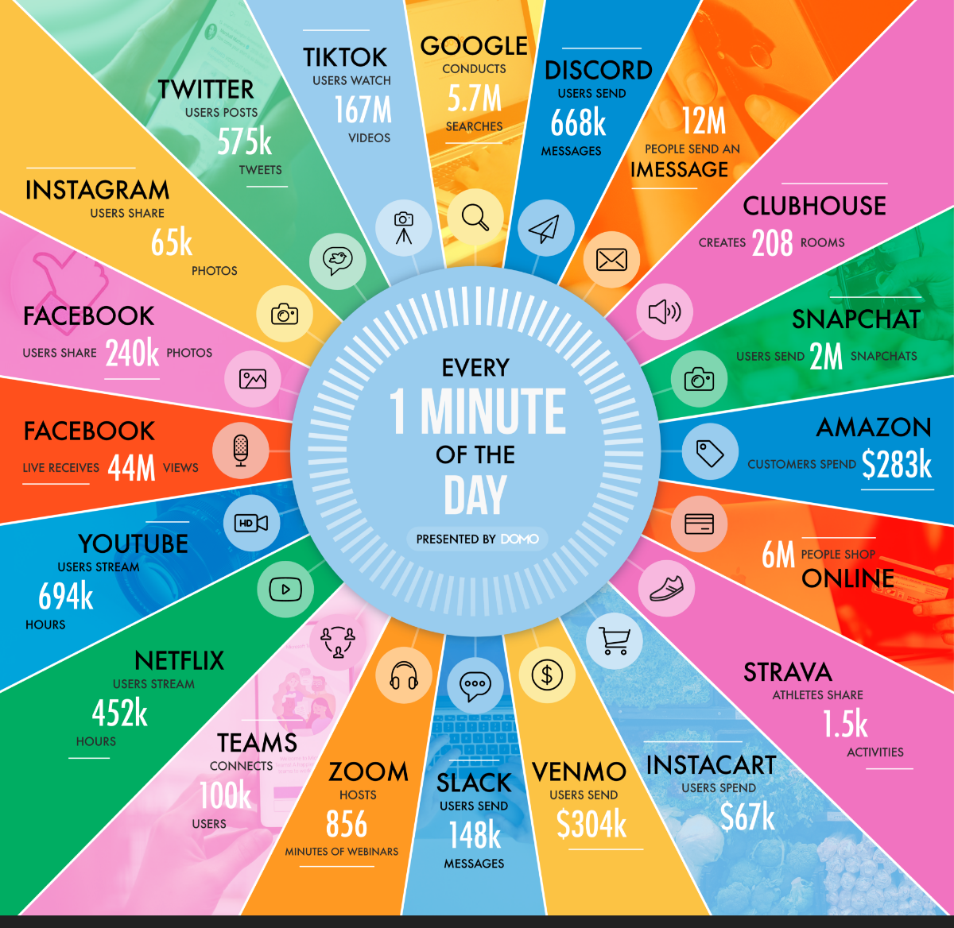
Do you have a minute?
This is what happens during an internet minute in 2021.

Slide 17
So who owns the internet?
Nobody is in charge of the internet, which means that anybody can put whatever they want onto it.
This can cause problems as offensive material can appear on the internet.
Fortunately, the police can track and identify everything that is posted as the Internet keeps track of all the computers connected to it.

Slide 18
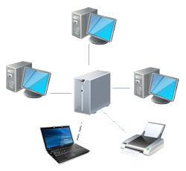
The School Network
Work Station
All the computers on our school network are controlled by a main computer called a “Server”.
This allows people to save their files centrally and share things like printers.
The computer you are using is called a “Work Station”.
Server

Slide 19
Accessing a network
All of us can use the school network – it’s called the c2k network that runs throughout Northern Ireland.
We each have login details to tell the server who we are. These login details include:
  A User ID – this is unique and no one else will have the same ID.
  A Password – this is chosen by you and only you should know it. This makes sure you are who you say you are.
Why is it important to keep this information secure and not to share it?

Slide 20
Setting a Strong Password
We must ensure we have a strong password.
A strong password will include:
  At least 8 characters – Some capitol and some lower case letters
  Use some numbers
  Use symbols like $, %, !, etc
It should not be:
  Easy to guess
  Be just a name
  The same as your username
  The same as any other password you have used.
Throughout the year, you may be asked to change your password.

Slide 21
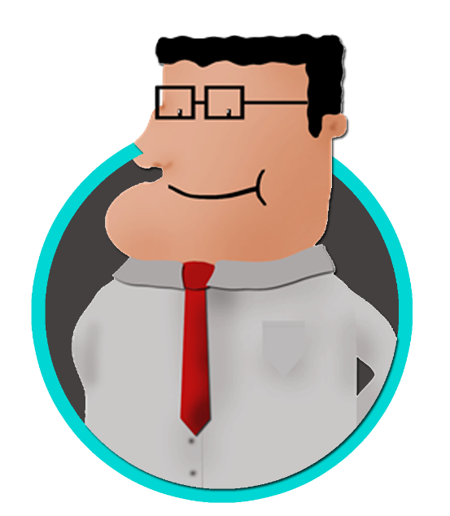
Questions
What is a network? [1]
What is a server? [1]
What is the Internet? [1]
Why does everyone need a unique Log In for the school network? [1]
What should be in a strong password? [5]
What activities are not acceptable on the school network? [7]
What could happen if I break the rules? [1]

Slide 22
File Management
Files and Folders

Slide 23

Why is it important to organise files?
Much easier to locate files
  always know where to find what you need
  You will never waste time wondering where to save anything
  Can easily direct someone/teacher to access a file for you
Easier to keep backups
No files need to be saved in several places
  No need to save files multiple times as you can’t find the first one you saved!
More efficient
If time is a limiting factor, can find file quickly
Marks.xlsx

Slide 24

Using Email and Search Engines
U01L03 | Mr Butler

Slide 25
Just Some of the Rules!
No Eating or Drinking in a Computer Suite (including chewing gum!).
Do not change any settings on the computer
You must not send inappropriate or upsetting messages – this is cyber bullying.
Report any damage to the teacher
Do not touch somebody else’s computer.
Do not play games or surf the internet whilst a lesson is taking place
Only use Google Classroom for Educational purposes

Slide 26
So – What is an email?
Email stands for ‘electronic mail’
It is a message sent from one computer to another over the internet.
In order to use email, you need:
  An email account (Gmail/Yahoo/AOL/Hotmail etc)
  Email software (Outlook/Webmail/Thunderbird etc)
  Internet Access (BT/Virgin/TalkTalk/Plusnet etc)

Slide 27
Are there rules to using Email?
Just like sending a letter in real life, sending an email follows the same rules.
It is a formal way to message someone, so should be professional.
Netiquette is a term used to show how you should behave when sending emails and using the internet.
  Be polite
  Never forget the subject line – who ever receives your email needs to know what it is about
  Do not type all in capitals as this looks like shouting
  Don’t use “text language”
  Let people know if you are joking by using a smiley face :) Emoticons!

Slide 28






The People involved in emails
There are two main groups when sending emails.
SENDER – the person who sends the email
RECIPIENT – the person who receives the email
When a message is sent, it appears in the recipient’s inbox
The recipient will need to open the email to read it
1. Sender Sends Email
4. Recipient can read the message.
3. Recipient Can open the email from their inbox
2. Email goes into Recipient’s inbox

Slide 29
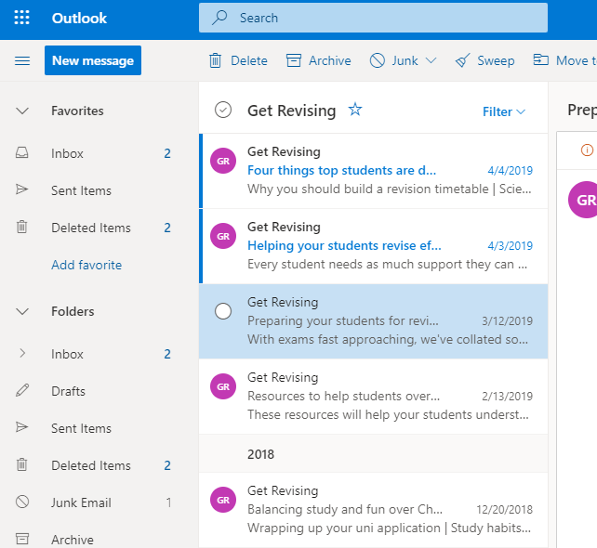
School Email
We use Microsoft Outlook.
Things to note for new emails:
  New (unread) emails come into our inbox and have a blue bar
  The Sender appears in bold
  The Subject appears in blue
  A preview of the message appears under the subject

Slide 30
Before we send an email:
We need to know the persons email address (where we are sending to)
  YOUR email address uses your username that you used to log in to the school computer.
    aperson123
    Followed by @c2ken.net
    This makes the full email address of aperson123@c2ken.net
__________________________________________________________
TIP: Take a note of your email address in your planner!

Slide 31

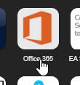
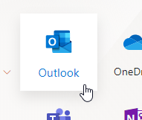

Sending an email
Open The Internet and go to MySchool
Click on Office365
Select Outlook
Select New Message

Slide 32
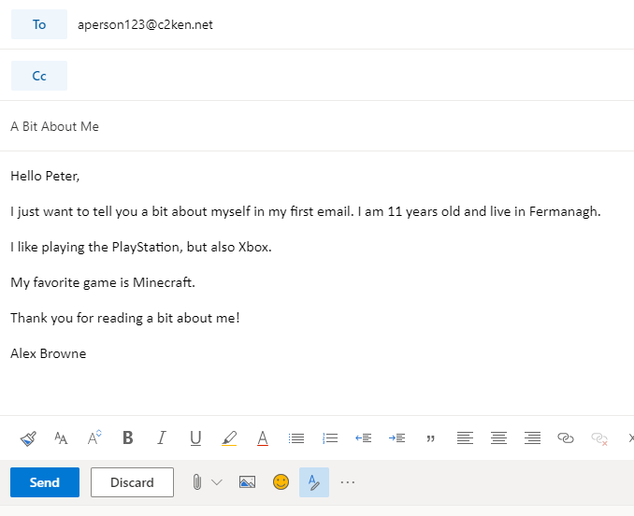
Type in the email address of a friend in this class
Add a meaningful subject line.
Add a Message using the correct language
Type in a suitable message to tell the recipient a little about yourself.
  Your favourite team
  A film you have recently seen or music artist you like
  A game you recently played.
Make sure you sign the email off to say who it’s from!
Click on Send.

Slide 33
Receiving email
When you receive an email, it will appear in your inbox.
Open your inbox and view your new message from a friend!
You will be able to see when it was sent, the subject (what it is about) and also be able to preview the start of the message!
Double click on the email to open and read it in full.

Slide 34

Replying to an Email
Once you receive an email, you will also be able to reply to the message.
When you reply to an email it means you are sending an email back to the person who originally sent it to you.
Because the message is going back to the person who sent it to you, the email address is automatically entered
RE appears in front of the subject to tell you it’s a reply

Slide 35

Forwarding Emails
We can also forward an email.
This is where you receive an email from one person, and instead of sending a message back, you send the message onto someone else
FW in the subject tells you it has been forwarded

Slide 36

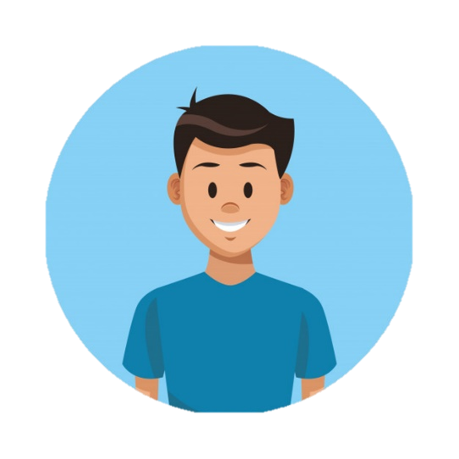
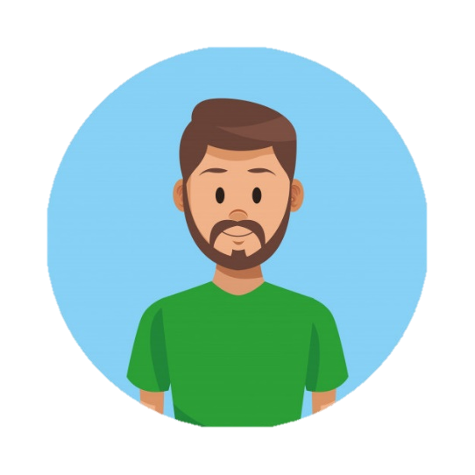
Jack can forward the email to Robert
Alex sends an email to Jack
Jack can reply to Alex’s email
Alex
Jack
Robert

Slide 37

Internet and the WWW
U01L04 | MR Butler

Slide 38

The Internet
The Internet is a massive global network of computers linked together.
It is physical hardware that is connected together.

Slide 39

The World Wide Web
The World Wide Web or WWW is the collection of millions of websites that sits on within the Internet.
We access the WWW through a web browser like Google Chrome, Firefox or Internet Explorer.
It is the software on the internet.

Slide 40
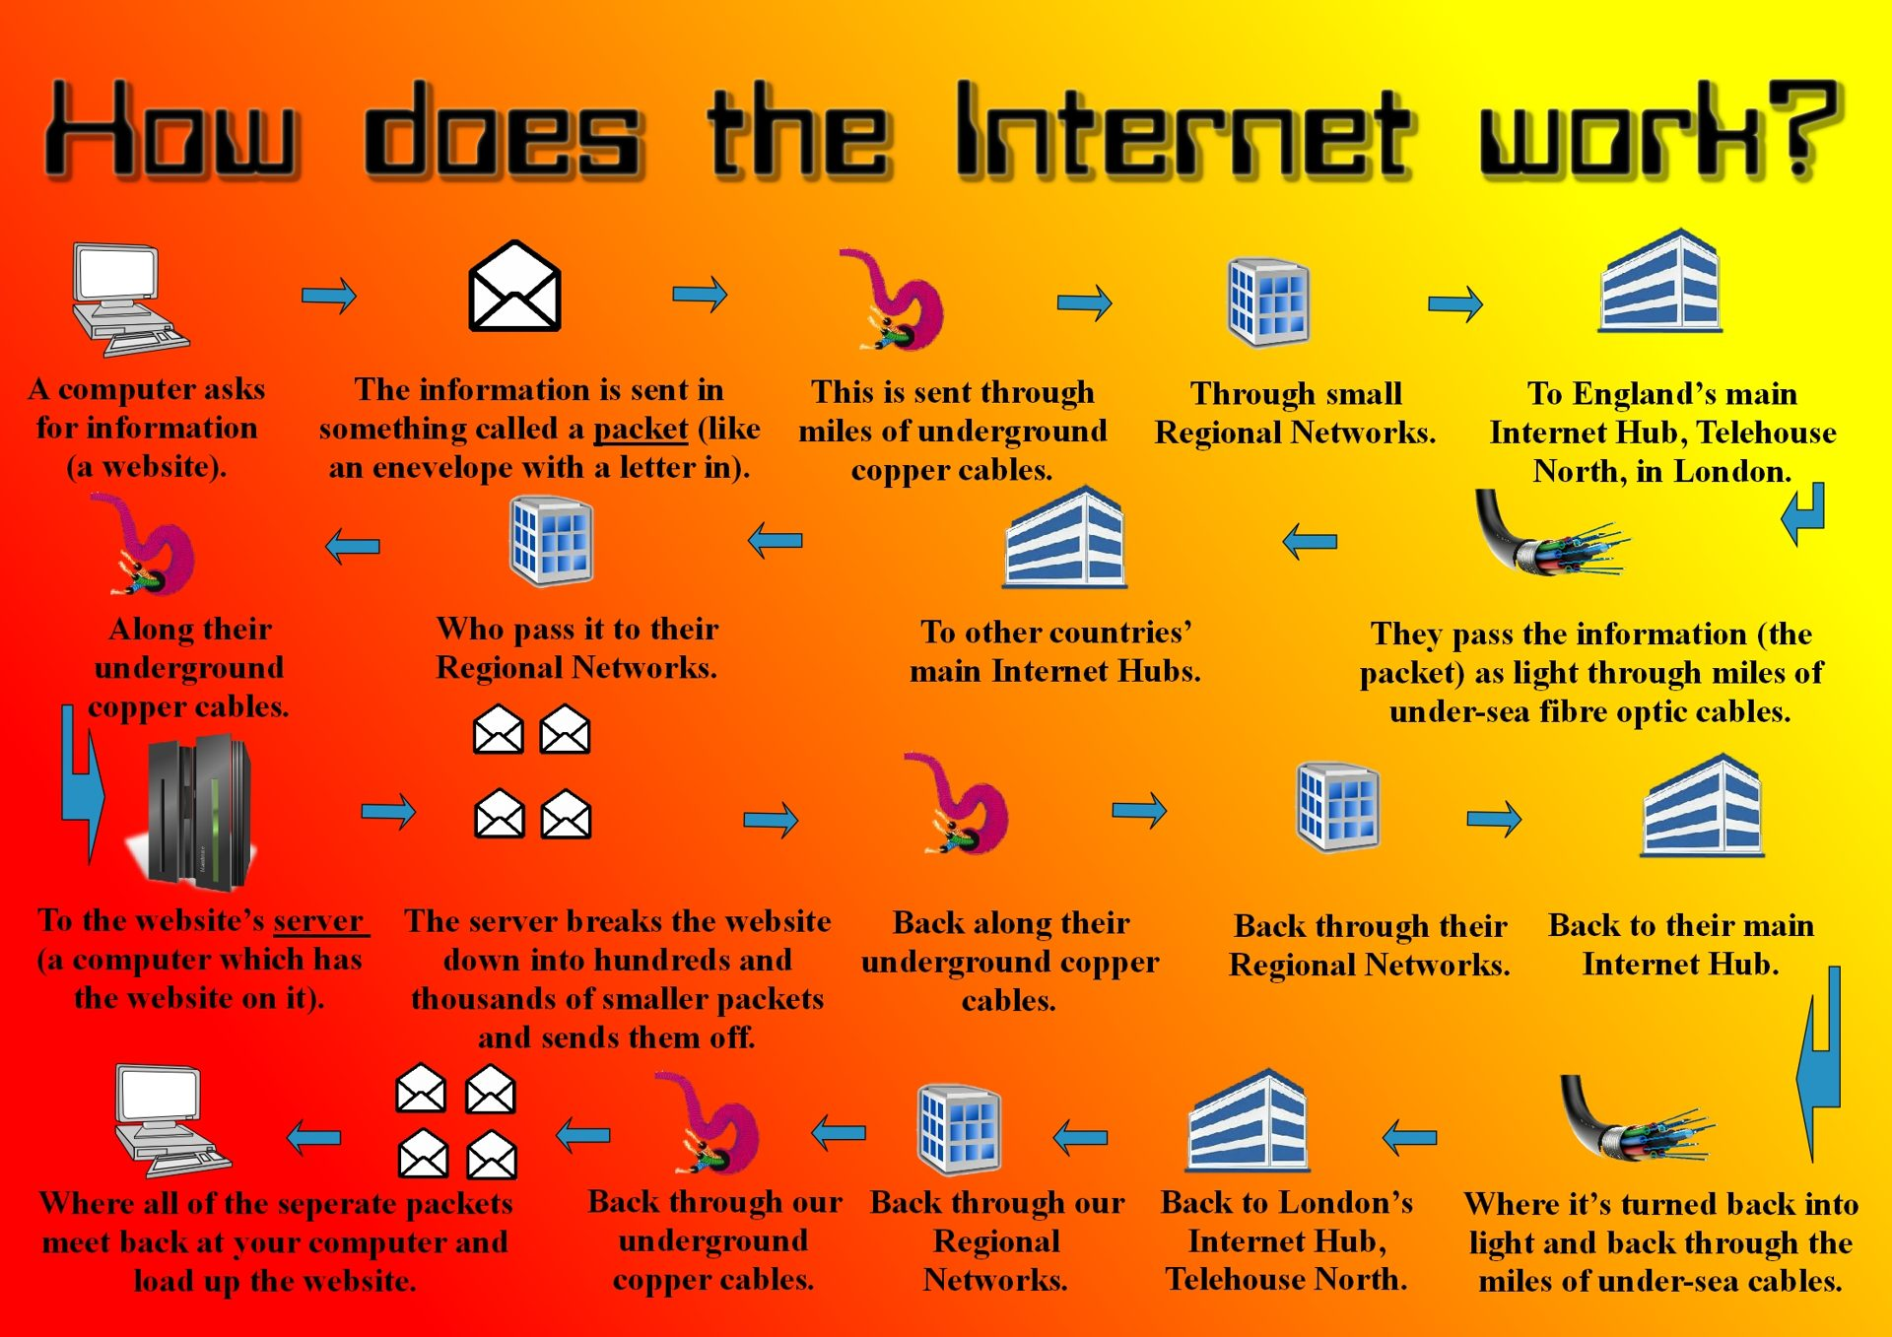
Notes:
Video Link: https://thekidshouldseethis.com/post/how-does-the-internet-work

Slide 41

Search Engines
Search Engines like Google use complex Algorithms to do three tasks:
  Crawling – where websites are discovered;
  Indexing - where a website is analysed and stored in huge database;
  Retrieval – You receive a list of relevant web pages on the topic you are searching for.
Notes:
Total websites: https://www.internetlivestats.com/total-number-of-websites/

Slide 42

Searching the WWW
6.51 billion pages on the WWW.
The size of the World Wide Web (The Internet) The Indexed Web contains at least 6.51 billion pages (Thursday, 13 February, 2020).
Google says that it stores information about those 30 trillion pages in the Google Index, which is now at 100 million gigabytes (2013). It has grown almost exponentially since.
Notes:
Total Number of Websites: https://www.internetlivestats.com/total-number-of-websites/

Slide 43

Web Searches
When we use a search engine such as Google or Bing, their web crawler creates a list of search results. These contain a list of relevant webpages, with the most relevant at the top.

Slide 44

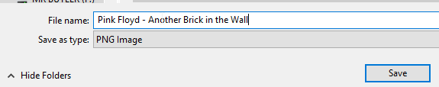
Click on the N:/ (the N Drive) to get to your area where you can save work.
Then Go to Year 8 > ICT > Unit 1
If you don’t have this file directory, you need to create one!
Give it a meaningful name and then click SAVE

Slide 45

Receiving an Attachment
We can also receive an email with an attachment from someone.
When we receive an email which has an attachment, the paperclip icon appears next to the message.
You can then open the email and also open or save the attachment!

Slide 46

What is a Computer Virus?
A virus is computer program designed to deliberately damage or make a computer system unreliable by slowing down the processor.
They have been created to cause damage to your computer, including:
  Corrupting files and folders
  Deleting Data
  Stealing your personal information
  Infecting your computer so it slows down/stops working

Slide 47
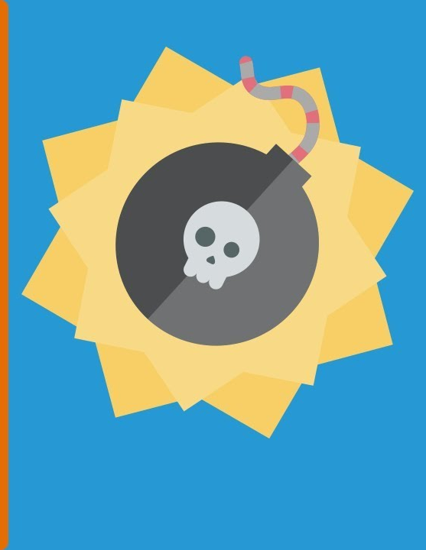
Avoiding Virus’
Do not open email attachments from people you do not know.
Install anti virus software on your computer and make sure you keep it up-to-date.
Do not download files from the internet unless it is from a known safe site and you have permission from a parent or guardian.
Scan USB memory sticks for viruses.

